Slide 1
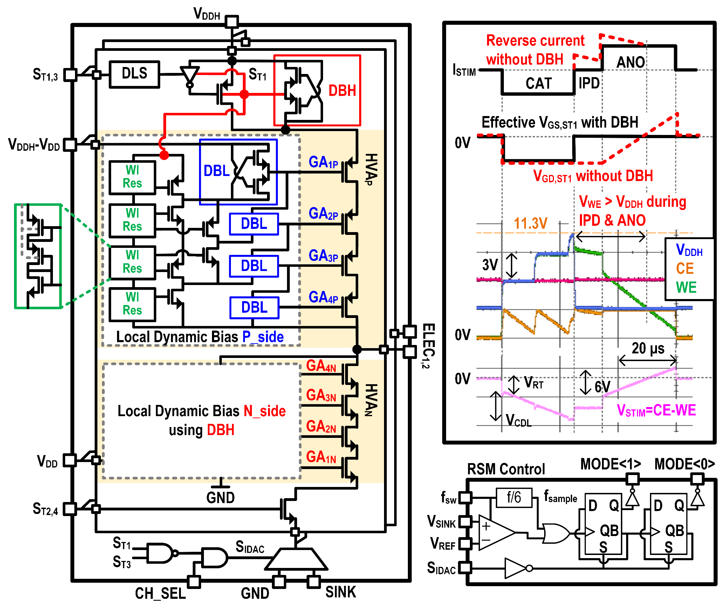
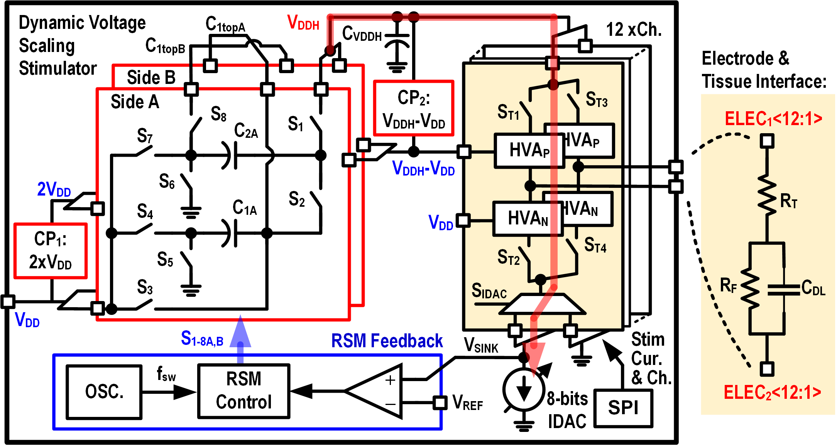
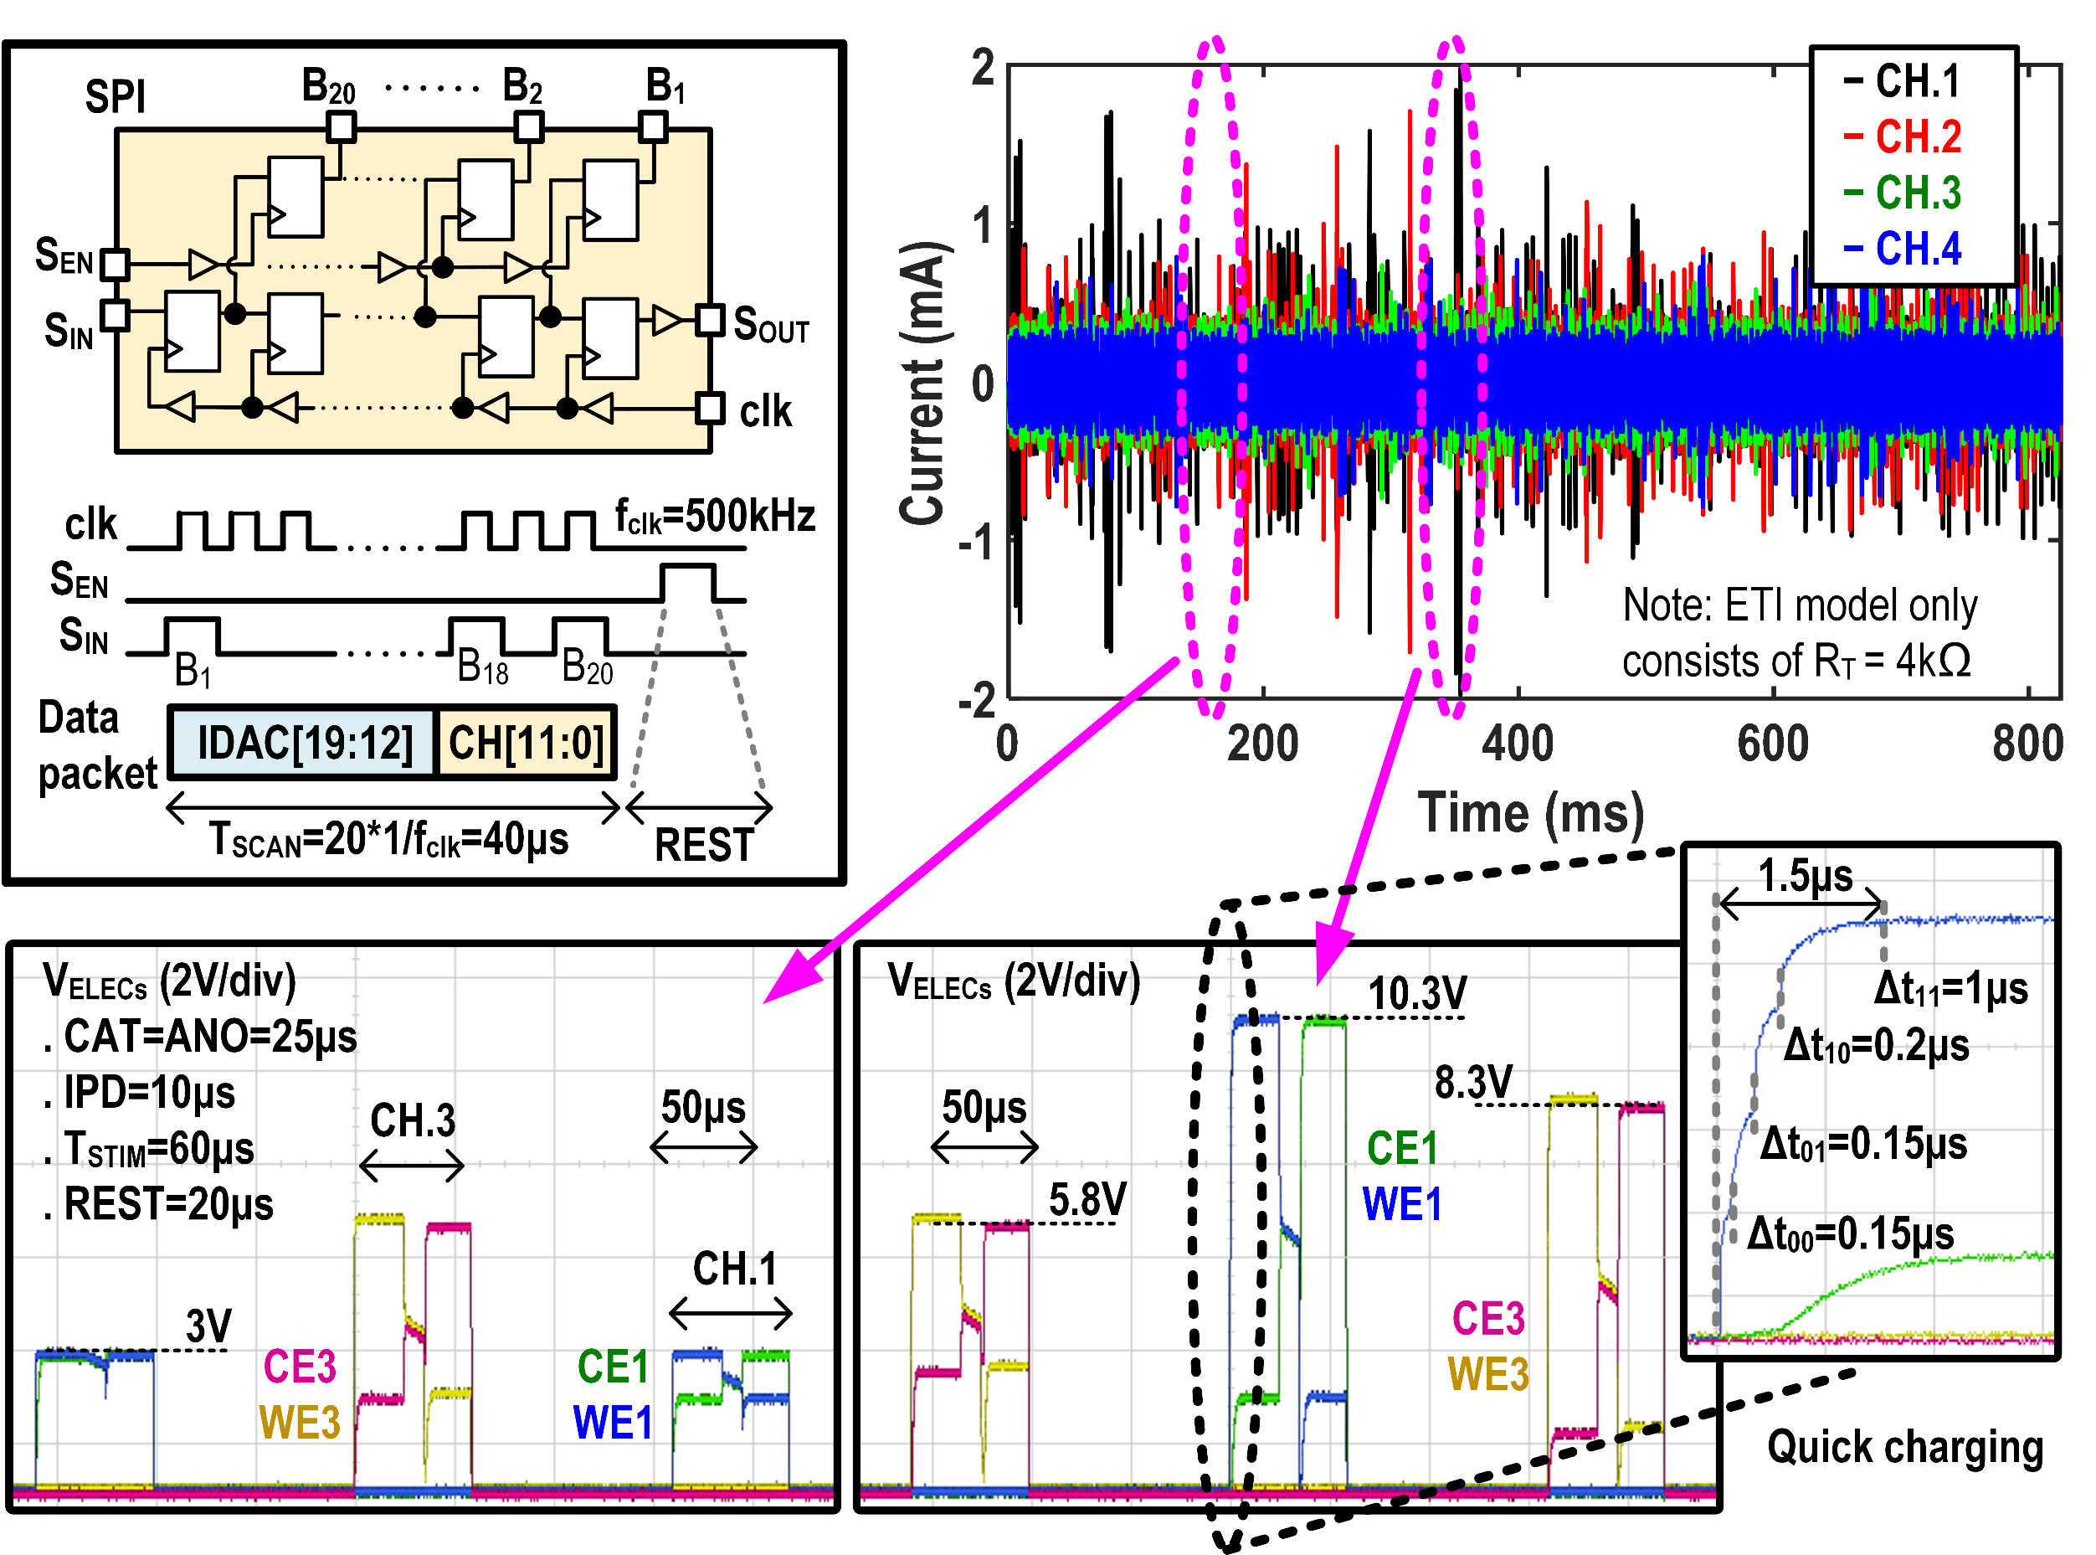
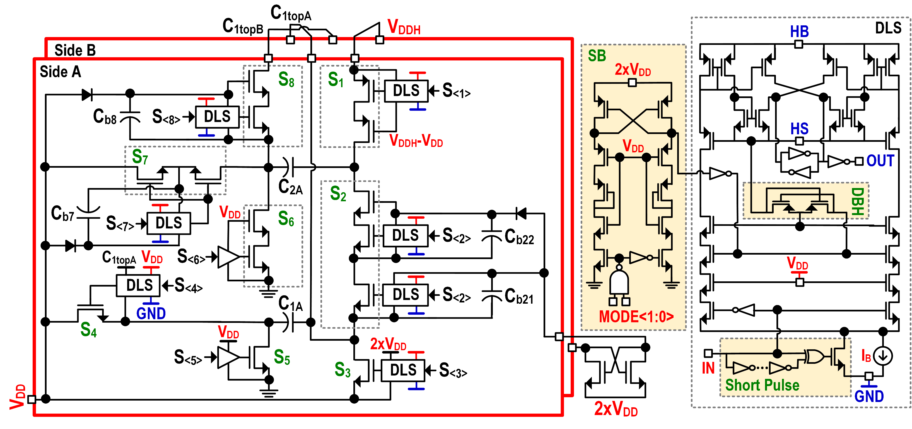
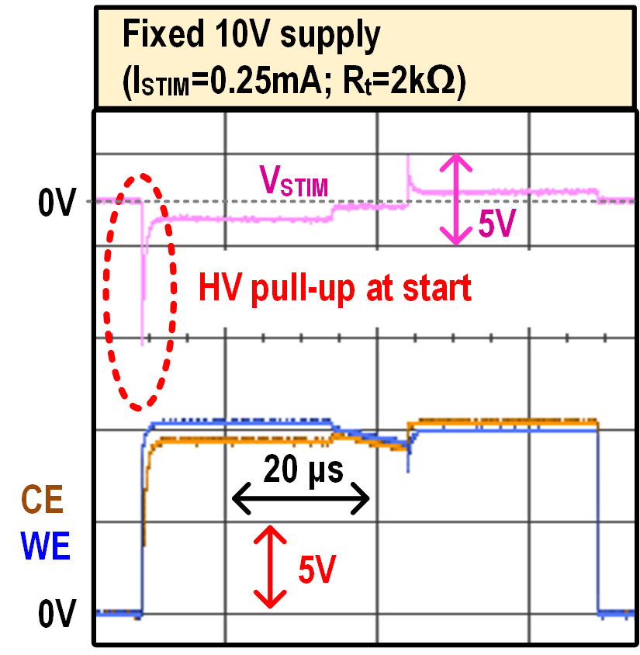
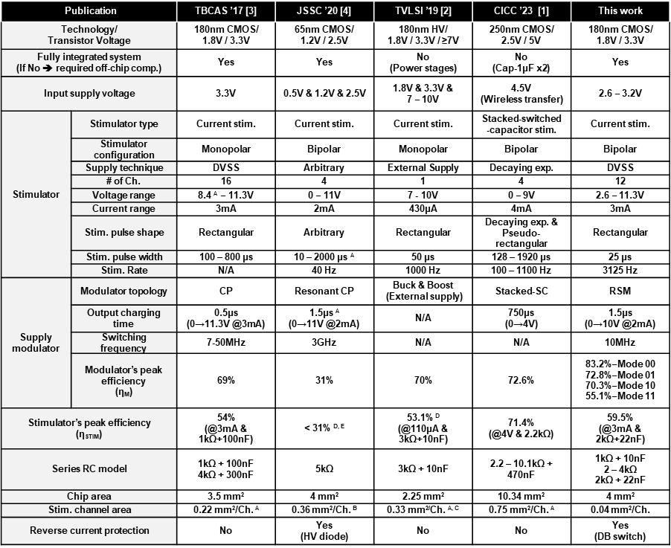
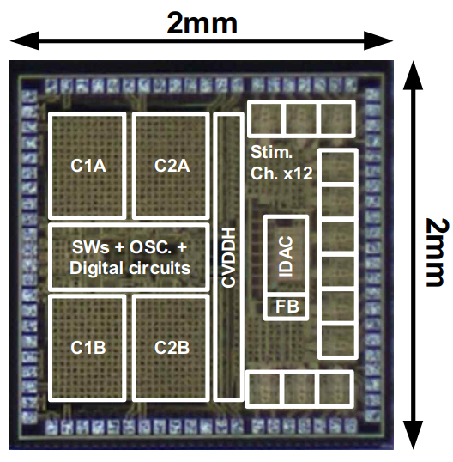
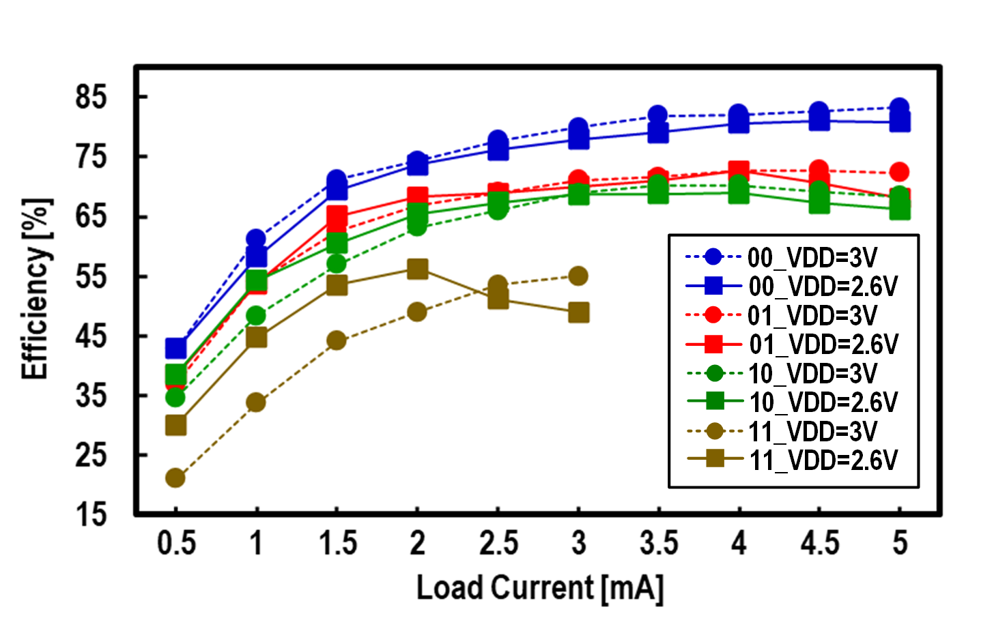
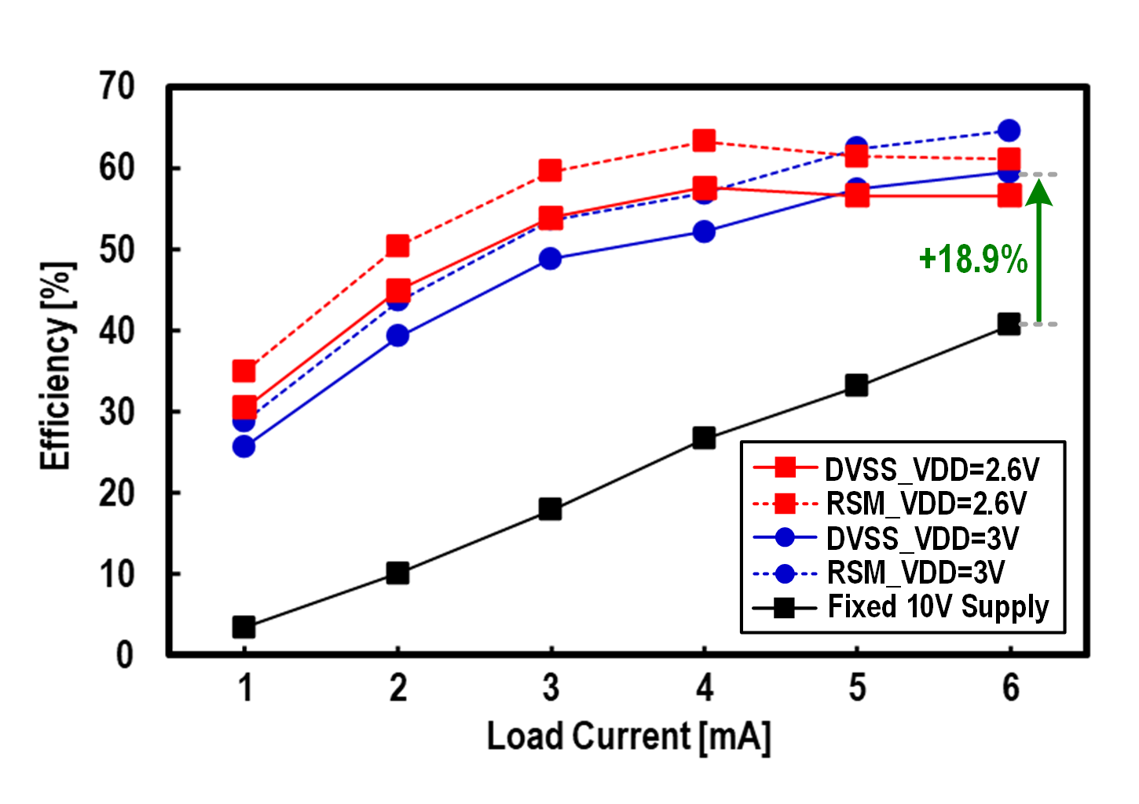
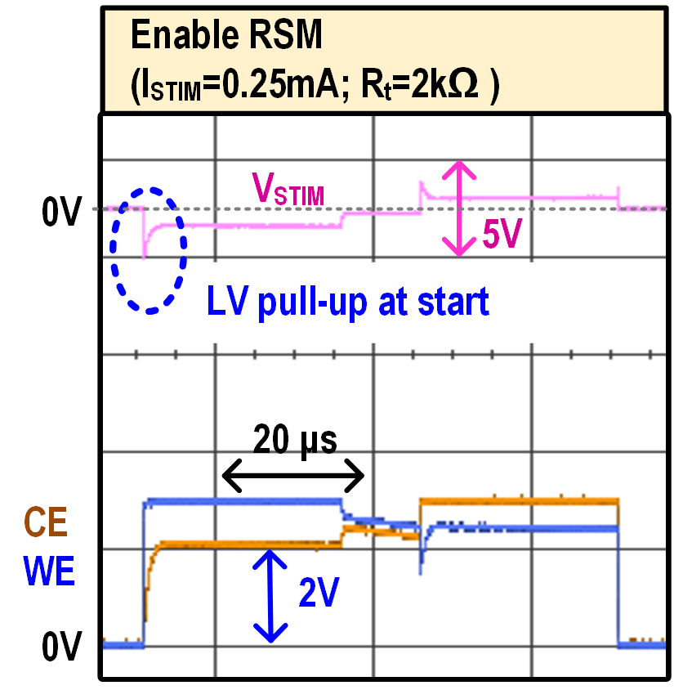
A Fully Integrated Dynamic-Voltage-Scaling Stimulator IC with Miniaturized Reconfigurable Supply Modulator and Channel Drivers for Cochlear Implants
Kim-Hoang Nguyen¹, Quyet Nguyen², Quynh-Trang Nguyen², Thanh-Tung Vu², Woojin Ahn³, Loan Pham-Nguyen², Hanh-Phuc Le⁴, and Minkyu Je¹.
¹KAIST, Daejeon, Korea, ²HUST, Hanoi, Vietnam, ³TODOC Co.Ltd., Seoul, Korea, ⁴UCSD, San Diego, USA.
E-mail: nkhoang@kaist.ac.kr; mkje@kaist.ac.kr, and loan.phamnguyenthanh@hust.edu.vn
Cochlear Implant & System Diagram
High-Voltage-Tolerant Channel Driver & RSM Feedback
Fully Integrated Dynamic-Voltage-Scaling Stimulator (DVSS): Reconfigurable Supply Modulator (RSM) & High-Voltage-Tolerant Channel Drivers
One branch of H-bridge and operation waveforms with I_{STIM} = 3mA and R_{T}/C_{DL} = 1kΩ/10nF
S_{T1-4} with reverse current protection:
Activate selected branch and protect I_{STIM} from excessive reverse current
High-voltage adapters:
Stack 4 devices (GA₁₋₄) to withstand stimuli voltage up to 4V_{DD}
Dynamically biased to adapt both LV and HV compliances
Minimize silicon area with weak-inversion-resistor (WI-Res) string
Multiplexer:
Enable IDAC stimulation current when the channel is selected
RSM feedback:
Monitor saturation level of IDAC to increase the supply voltage
R_{T} : up to 5kΩ
C_{DL} : at least 10nF
I_{STIM} : up to 2mA
+ Variable audio amplitude
HV capability (>10V) + Dynamic supply modulator
Reconfigurable Supply Modulator
Implementation Results
Four operational MODE [00:11] to modulate VDDH to one of 4 voltage levels [V_{DD}:4V_{DD}]
Serial-peripheral-interface (SPI) to inject external control signal to generate the audio pattern of the word “annyeonghaseyo” (meaning “hello” in Korean)
SPI:
20-bit package including IDAC and CH_SEL data
Updated at the end of every stimulation cycle
Audio pattern:
Wide dynamic voltage and current ranges (10.3V and 2mA, respectively)
Instantaneous voltage response with the charging time form 0 to 10V taking only 1.5μs
Detailed schematic of the proposed RSM with dynamic level shifter (DLS) circuit
Stimulation voltages in the cases with and without RSM
Performance comparison with state-of-the-art stimulators:
Dual-phase operation between sides A & B provides continuous charging to C_{VDDH}, allowing small capacitance value for integration (C_{VDDH} = 115pF).
HV switches are stacked by 2 to 3 devices to satisfy HV requirements during different MODEs.
Bootstrap circuits for power switches are employed by charge pumps and RSM’s switching voltages.
Dynamic level shifters can function corresponding to multiple V_{DDH} levels.
Die Micrograph & Efficiency Diagrams
RSM efficiency diagram
Stimulator efficiency diagram
Conclusion
The proposed DVSS can adapt a wide stimulation voltage range from 2.6 up to 11.3V. Its fast-charging capability and reverse current protection make it suitable for CIs with variable stimuli currents and ETI impedance. The stimulator efficiency is also improved when compared to other current stimulators [2]-[4], thanks to efficient RSM. Furthermore, the proposed DVSS requires no off-chip components while showing a significant reduction in silicon area with miniaturized channel drivers by using the standard CMOS process, enabling the implementation of multiple stimulation sites within a single IC
Acknowledgement
The chip fabrication was supported by the IC Design Education Center. This work was supported by the Electronics and Telecommunications Research Institute under Grant 23ZB1140 and by the Ministry of Science and ICT under Grants 2022M3C1A3091627 and 2022M3E5E9018349. The author would like to thank Hyundai Motor for the Chung Mong-Koo Scholarship.

